Slide 1
Spherical Trigonometry
Math 12

Slide 2
Introduction
Sphere: is a curved surface every point of which is at an equal distance from a single point inside the surface called the center and the line joining the center with any point on the surface is called the radius.

Slide 3
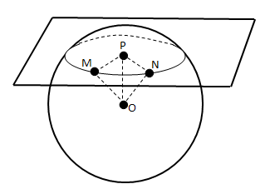
If a plane intersects a sphere, the intersection is always a circle
O = center of sphere
M,N= arbitrary points on the intersection of the plane and the sphere.
P = point perpendicular to the plane from O
Right triangle OPM ≈ OPN, since OM and ON are radii and P is the center of the circle (created by the intersection of the plane and the sphere.

Slide 4
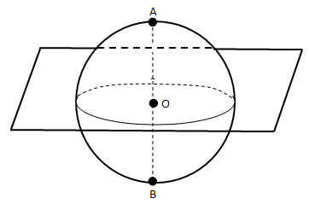
Great Circle
Great Circle: is the intersection of a sphere with a plane through the center of the sphere.
Great Circle with O as the center of the plane which is also the center of the sphere.
Otherwise, if the intersecting plane does not pass through the center of the sphere, then the intersection is called a small circle.

Slide 5
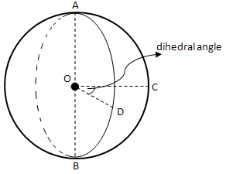
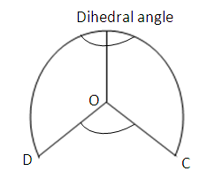
Poles of a Great Circle
Poles of a Great Circle: are the points in which the sphere is cut by the line through the center of the sphere perpendicular to the plane of the great circle.
Two great circles divide the sphere into 4 parts, each of which is called a lune.
ACBDA is a lune.
Any angle formed by two great circles is measured by the dihedral angle between the planes of the great circles forming the sides of the lune. Thus, COD measures each of the two equal angles A and B of the lune.

Slide 6
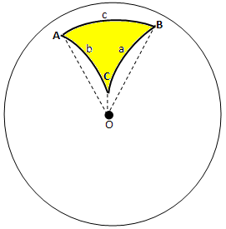
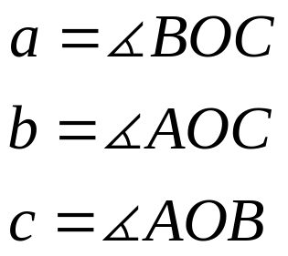
Spherical Triangle
ABC is a spherical triangle. The angles are denoted by A, B, and C; and the three sides by a, b, and c, respectively

Slide 7
Spherical Triangle: is a portion of the spherical surface bounded by the arcs meeting in three points.
The sides a, b, and c as well as the angles A, B, and C will be measured in degrees.
Point O, which is the center of the sphere is the apex of the trihedral angle O-ABC.
The sides a, b, and c measured in degrees are equal to the corresponding face angles BOC, AOC and AOB of the trihedral angle, respectively.
Although spherical triangles maybe constructed with one or more sides or angles greater than 180°, we shall restrict ourselves in considering only those with sides and angles less than 180°.

Slide 8
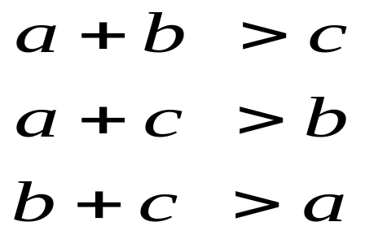
Some Properties and Theorems:
The sum of the sides of a spherical triangle is less than 360°. That is, (a+b+c)<360°.
A side of a spherical triangle is less than 180°.
The sum of the angles of a spherical triangle is greater than 180° and less than 540°, that is, 180°<(A+B+C)<540°.
The sum of any two sides of a spherical triangle is greater than the third side.
If two sides of a spherical
triangle are unequal, the
angles opposite them are
unequal; and the greater side
lies opposite the greater angle.

Slide 9
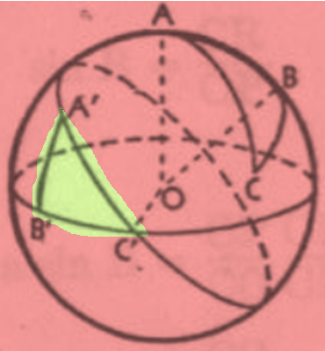
Polar Triangles
By taking each of the vertices of a spherical triangle ABC as a pole and constructing a great circle, we obtain a set of spherical triangles.
If arcs of great circles are drawn with the vertices of a spherical triangle as poles, these arcs form a second triangle called the polar triangle of the first.

Slide 10
Polar Triangles
Suppose that:
Vertex A is the pole of arc B’C’;
Vertex B is the pole of arc A’C’; and
Vertex C is the pole of arc A’B’.
Then, AO is perpendicular to plane B’C’O and therefore to line C’O.
Likewise, BO is perpendicular to line C’O.
Since, C’O is perpendicular to two lines in the plane ABO, it is perpendicular to the entire plane.
Then, C’ is the pole of arc AB.
Similarly, B’ is the pole of arc AC, and
A’ is the pole of arc BC.
Therefore, ABC is the polar triangle of A’B’C’. We shall say that spherical triangles ABC and A’B’C’ are mutually polar triangles.

Slide 11
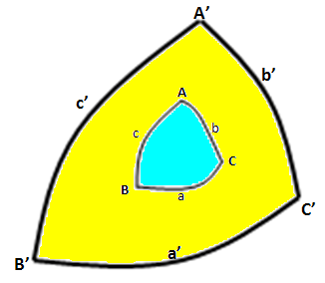
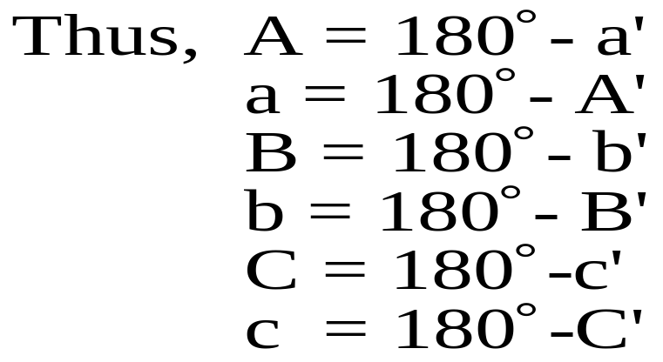
Polar Triangles
In solid geometry, it is proved that if A’B’C’ is the polar triangle of ABC, then ABC is the polar triangle of A’B’C’.
And that each angle of a spherical triangle is the supplement of the corresponding side of the polar triangle.
The polar triangle A’B’C’ of ABC has the property that:
A and A’ lie on the same side of a
B and B’ lie on the same side as b
C and C’ lie on the same side of c

Slide 12
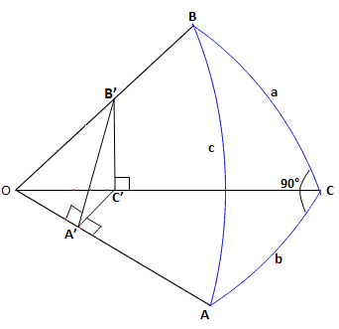
Right Spherical Triangle
Right Spherical Triangle: is a spherical triangle with one angle equal to 90°.
ABC is a right spherical triangle.
Notes:
ABC

Slide 13
Right Spherical Triangle
Through any point A’ of OA pass a plane perpendicular to OA, intersecting the faces of trihedral angle O-ABC in A’B’, B’C’, C’A’
The plane angle C’A’B’ measures the angle A of the spherical triangle.
If the plane OCB is vertical, and the plane OCA is horizontal (the figure can always be so drawn), it follows that the plane A’B’C’ is vertical and that the angles OC’B’, OA’B’, OA’C’ and A’C’B’ are right angles.
Then,

Slide 14
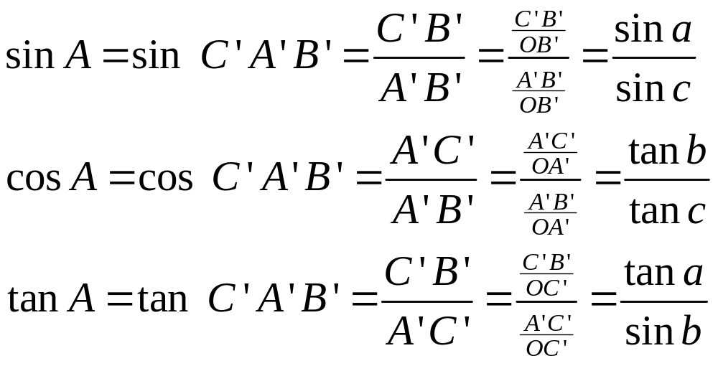
Right Spherical Triangle

Slide 15
Right Spherical Triangle
Thus, we have the ff. formulas:
1. sin a=sin c sin A
2. tan b = tan c cos A
3. tan a = sin b tan A
By drawing a plane perpendicular to OB and proceeding in the same as above, we find the following:
4. sin b = sin c sin B
5. tan a = tan c cos B
6. tan b = sin a tan B
From formulas 1 to 6, four other formulas may be deduced;
7. cos c = cos a cos b
8. cos c = cot A cot B
9. cos A = cos a sin B
10.cos B = cos b sin A

Slide 16
Right Spherical Triangle
The 10 formulas above have been derived from the spherical triangle ABC where angles A and B are each less than 90° and angle C is a right angle.
Other statements we may find useful for right spherical triangle:
I. If c<90°, a and b are either both less or both greater than 90°. Each of the sides a and b is less than 180°.
II. If c>90°, one of the other sides is less and the other greater than 90°.
III.If A and a are either both less or both greater than 90°, the same is true of B and b (this follows from equation 3 and 6).

Slide 17
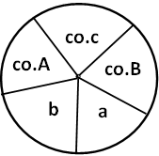
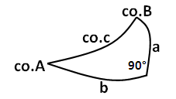
Napier’s Rule
The 10 formulas may be collected into two simple rules formulated by John Napier, the inventor of logarithms.
In any right spherical triangle, a and b; and the complements of A, c, and B (co.A, co.c, co.B) are the five circular parts.

Slide 18
Napier’s Rule
If we select any one of the five parts, it has two adjacent parts and two opposite parts.
Napier’s rules are:
1. The sine of any circular part equals the product of the tangents of the adjacent parts-(the “tan-adj.” rule)
Example: sin a = tan b tan(co.B)
sin a = tan b cot B (formula 6)
2. The sine of any circular part equals the product of the cosines of the opposite parts-(the “cos-opp.” rule)
Example: sin a = cos(co.c) cos(co.A)
sin a = sin c sin A (formula 1)

Slide 19
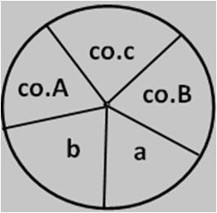
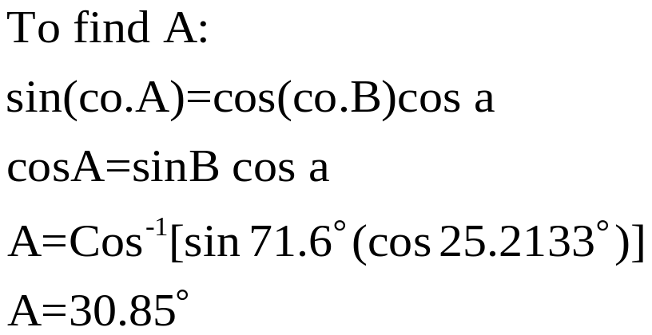
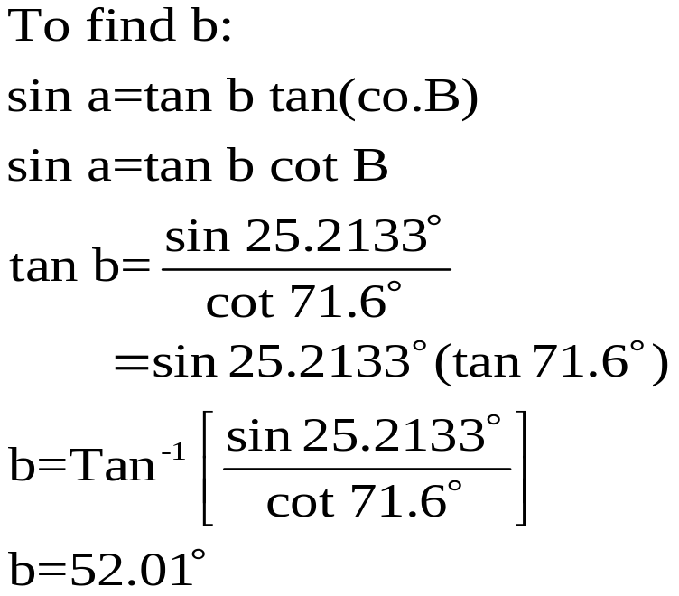
Solutions of Right Spherical Triangles
Napier’s Rule or the formulas 1 to 10 are sufficient to solve a right spherical triangle with two parts given besides C=90°
A. By Napier’s Rule
Example1: Given: a= 25°12.8’=25.2133° and B=71°36’=71.6°. Find A, b, and c.

Slide 20
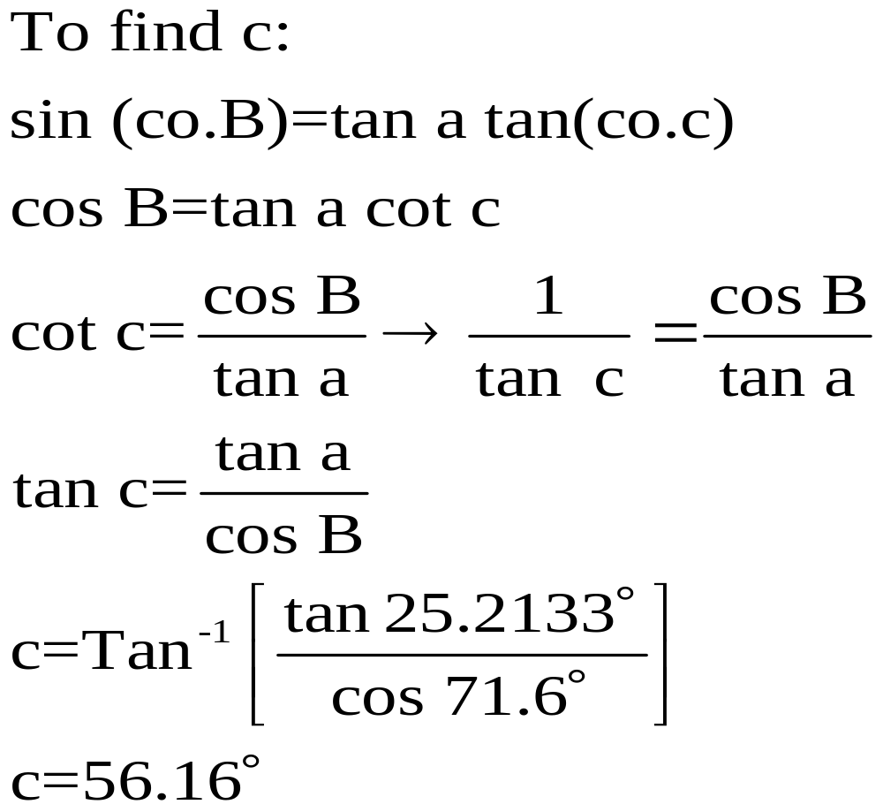
Solutions of Right Spherical Triangles

Slide 21
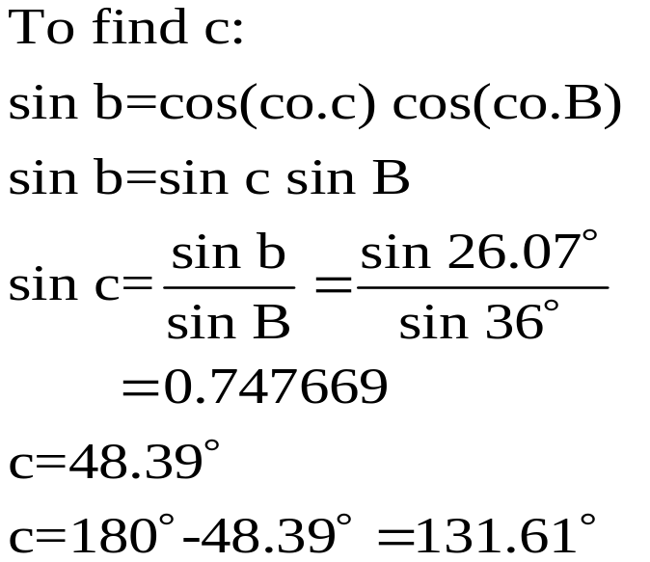
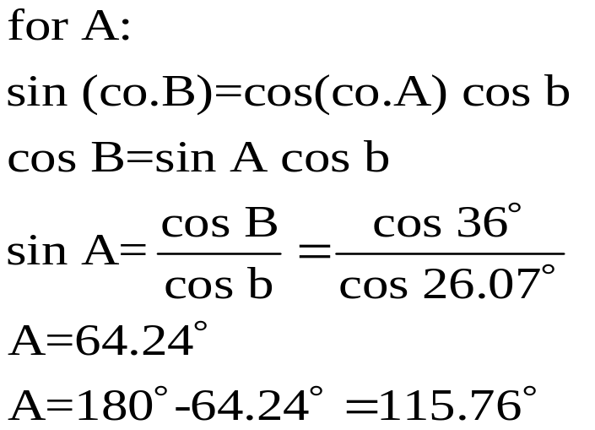
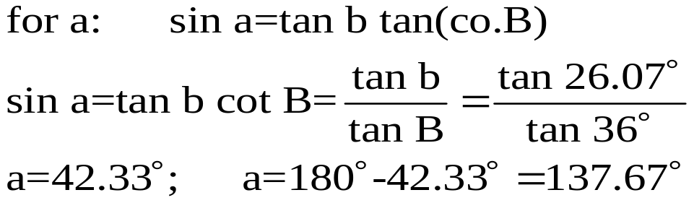
Solutions of Right Spherical Triangles
Example 2: Ambiguous Case
Given: b= 26.07° and B=36°; Find c, A, and a.

Slide 22
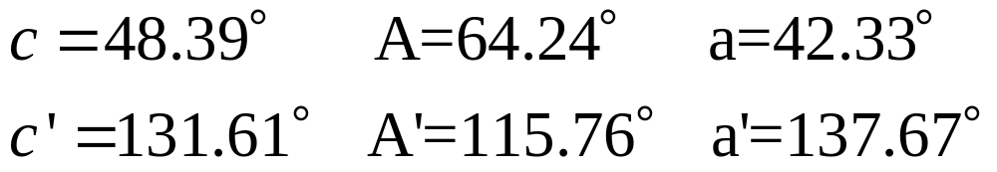
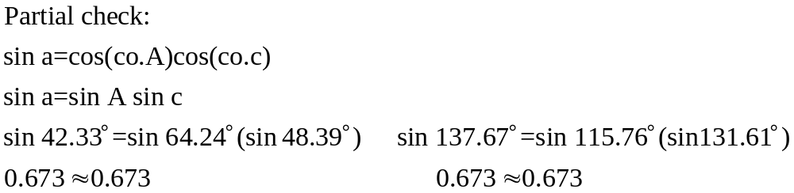
Solutions of Right Spherical Triangles
Since in this case, each of the unknown part is determined by the sine; and we are restricting each part to be less than 180°, we are led to two values for each unknown part.
Note: If a part is determined from cosine, tangent or cotangent, there is only one value for this part.

Slide 23
Solutions of Right Spherical Triangles
It does not follow that these values can be taken in every possible way, since there are 8 possible combinations of two solutions for each of the values of c, A, and a.
An application of the statements below limits the results to the following values, which show that there are only two admissible solutions
I. If c<90°, a and b are either both less or both greater than 90°. Each of the sides a and b is less than 180°.
II. If c>90°, one of the other sides is less and the other greater than 90°.
III. If A and a are either both less or both greater than 90°, the same is true of B and b (this follows from equation 3 and 6).

Slide 24
Solutions of Right Spherical Triangles
For the first set of values:
Application of statement I, c<90°, a=42.33° and b=26.07° are both less than 90°
Application of statement III, A and a are both less than 90° so as with B and b.
For the 2nd set of values:
Application of statement II, c’>90°, [b=42.33°]<90° and a’>90°
Application of statement III, A’ and a’ are both greater than 90°; and B and b are both less than 90°
B. By using appropriate equations from 1 to 10 and without using Napier’s Rule
As noted earlier, there maybe two possible solutions of the triangle when a part is determined from the sine. Check for admissible solutions applying the conditions stated in I, II, and III

Slide 25
Quadrantal Triangles
Quadrantal triangle is a spherical triangle whose one of the sides equals 90°.
Since each side of a spherical triangle is the supplement of the corresponding angle of its polar triangle, the polar triangle of a quadrantal triangle is already a right spherical triangle.
A = 180° - a’
a = 180° - A’
Hence, by solving this polar triangle and taking the supplements of its computed parts, we obtain the unknown parts of the original quadrantal triangle.

Slide 26
Quadrantal Triangle
Illustration: Given a quadrantal triangle with c=90°, C=115.3°, A=42.2°, solve the triangle.
Denoting the polar triangle by A’B’C’ and sides by a’, b’, and c’, we have:
C’=180°-c=180°-90°=90°
c’=180°-C=180°-115.3°=64.7°
a’=180°-A=180°-42.2°=137.8°
With these values, we can solve this polar triangle with the 10 formulas or by Napier’s Rule since this polar triangle is a right spherical triangle. Yielding,
B’=115.39°
A’=132.04°
b’=125.26°

Slide 27
Quadrantal Triangle
Then, we can now solve for the original quadrantal triangle by taking the supplements of the values above:
a=180°-A’=180°-132.04°=47.96°
b=180°-B’=180°-115.39°=64.61°
B=180°-b’=180°-125.26°=54.74°

Slide 28
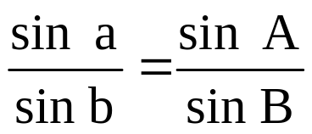
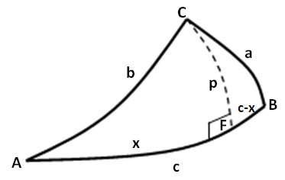
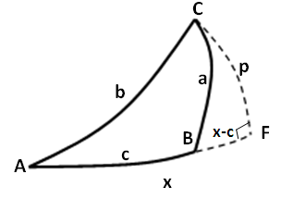
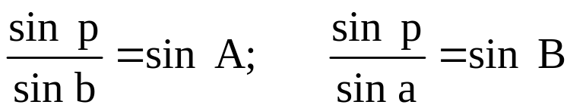
Oblique Spherical Triangle
Law of Sines:
In any spherical triangle ABC,
Proof: In the spherical triangle ABC in the figure, draw the altitude CF=p forming right spherical triangle AFC and BFC.
From formula 1 of right spherical triangle, to each of these triangles,

Slide 29
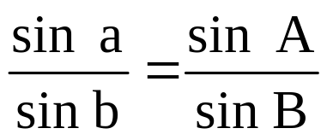
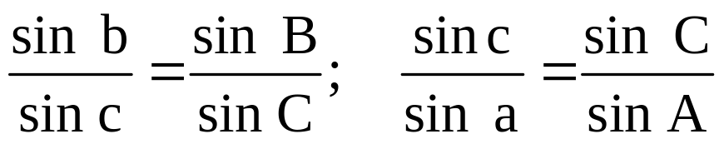
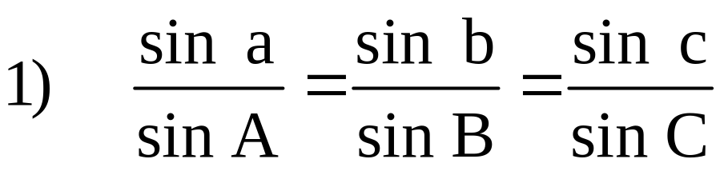
Oblique Spherical Triangle
Dividing the 1st by the 2nd equation,
In similar manner, we write
Thus, the results are written,
Law of Sines:
“In any spherical triangle ABC, the sines of the sides are proportional to the sines of the opposite angle.”

Slide 30
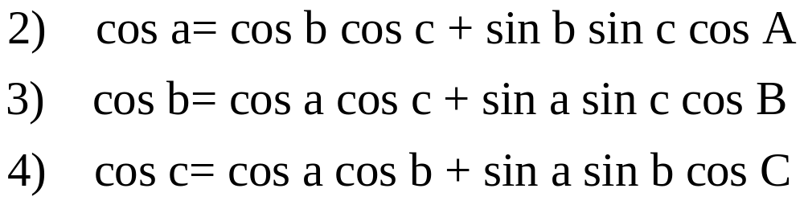
Oblique Spherical Triangle-Law of Cosines
Law of Cosines for spherical triangles (for sides)
Law of Sines may be used for the ff. cases:
When two angles and the side opposite one of them are given.
When two sides and the angle opposite one of them are given.
Law of Cosines may be used for the ff. cases:
When two sides and their included angle are given.
When three side are given.

Slide 31
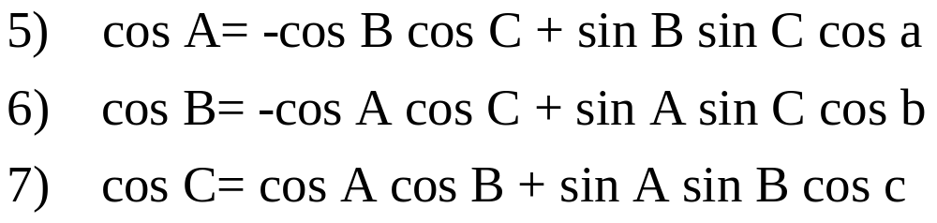
Oblique Spherical Triangle-Law of Cosines
Formulas for cos A, cos B and cos C:
Consider the polar triangle A’B’C’ of triangle ABC, from formula (2)
Replacing by:
We obtain,
Law of Cosines for Angles

Slide 32
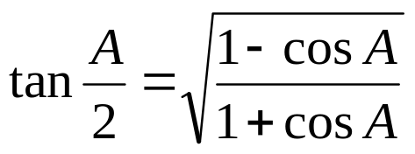
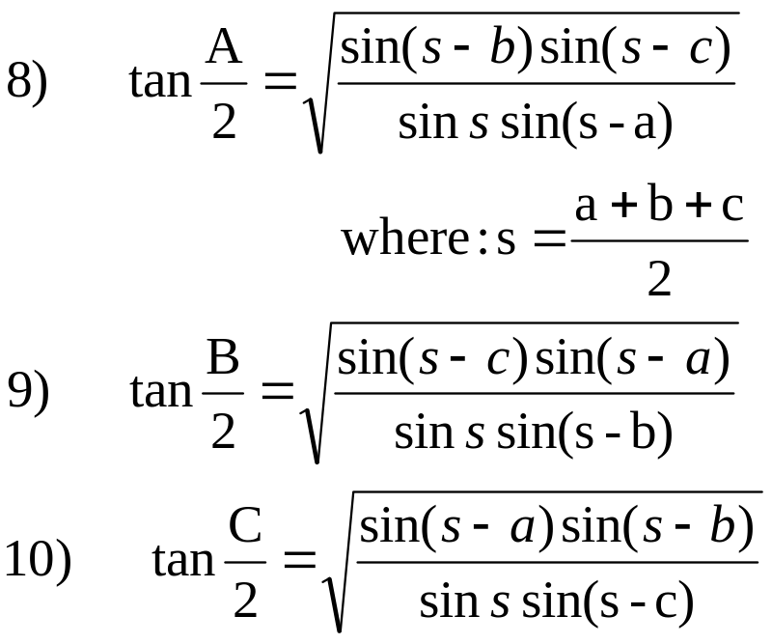
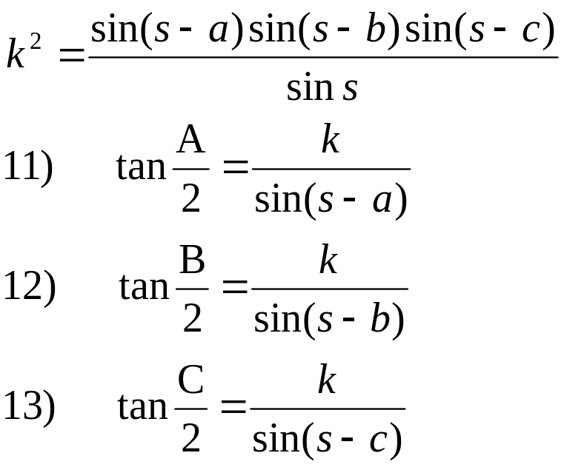
Half-Angle Formulas
Half-Angle Formulas
When three sides are given and using formulas (2), (3) and (4) and from
we obtain,
By setting,
Notes:
By setting

Slide 33
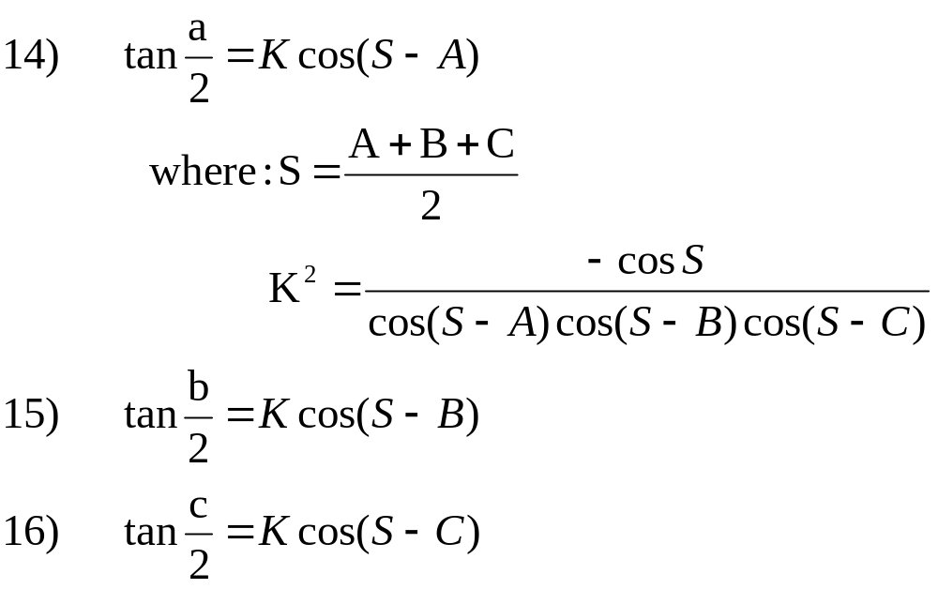
Half-Side Formulas
Half-Side Formulas
Given a spherical triangle ABC with its angles known and applying formulas (11), (12), and (13) to the polar triangle A’B’C’ of ABC. Then setting S=(A+B+C)/2 and taking the supplements of A, B, and C to yield a’, b’ and c’ and setting 1/k’=K, we will have,
Similarly,
Notes:
similarly

Slide 34
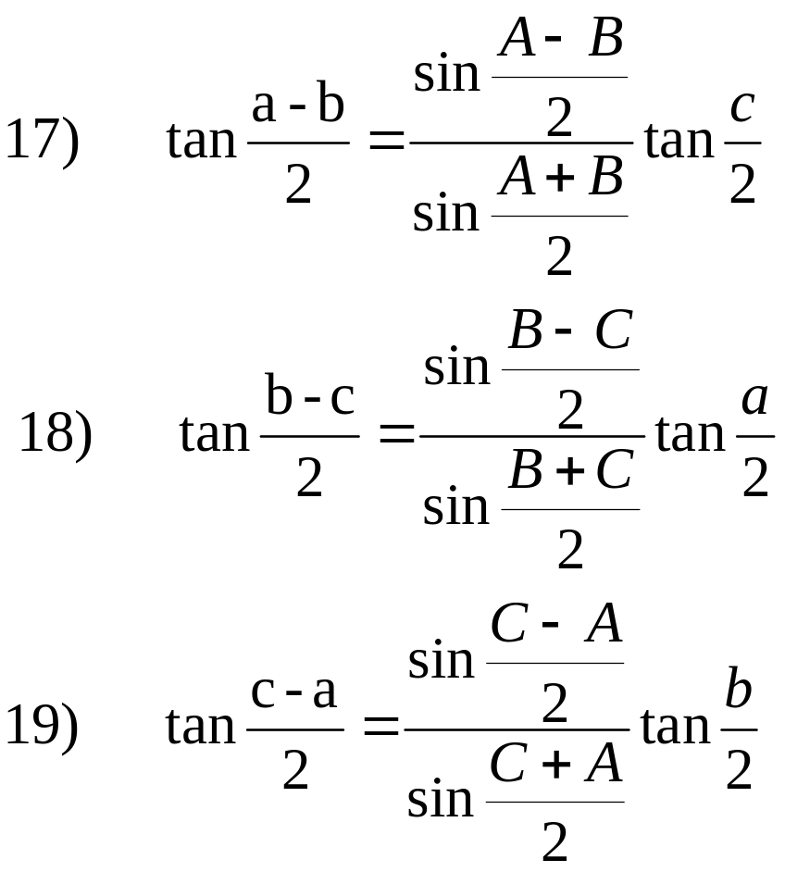
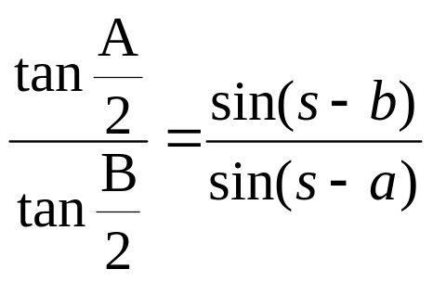
Napier’s Analogies
And applying concepts of proportion and reduction, we obtain:
Napier’s Analogies
If two sides and their included angle, or two angles and their included side are given, we make use of a set of formulas known as Napier’s Analogies.
By dividing equations (11) by (12)
Notes:
And applying concepts of proportion and reduction, we obtain:

Slide 35
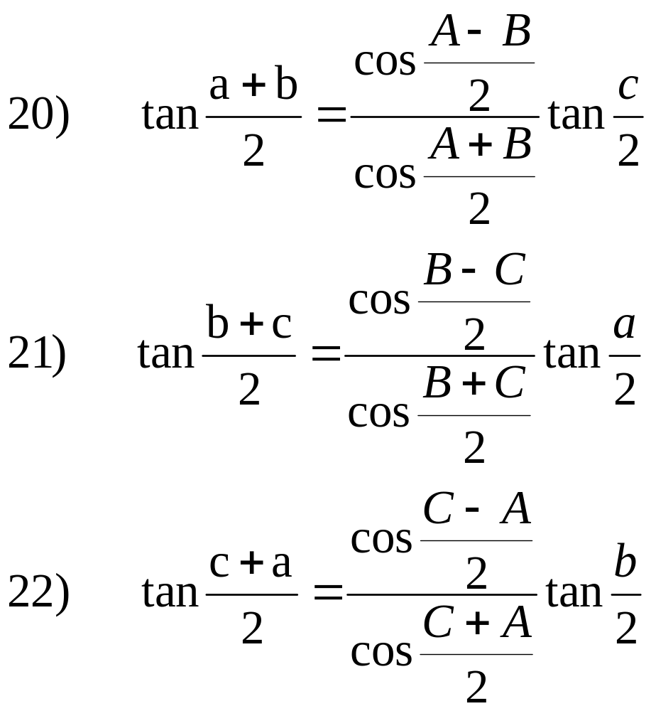
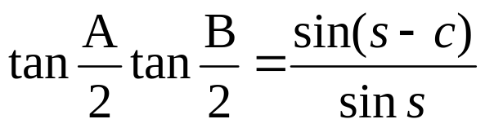
Napier’s Analogies
By multiplying (11) and (12)

Slide 36
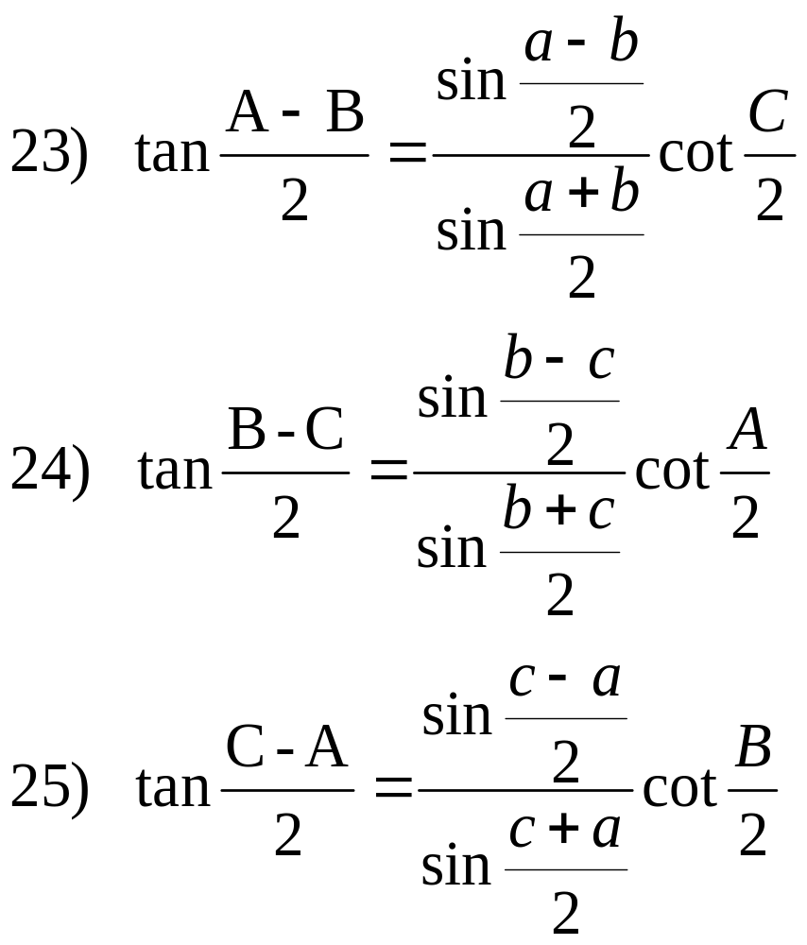
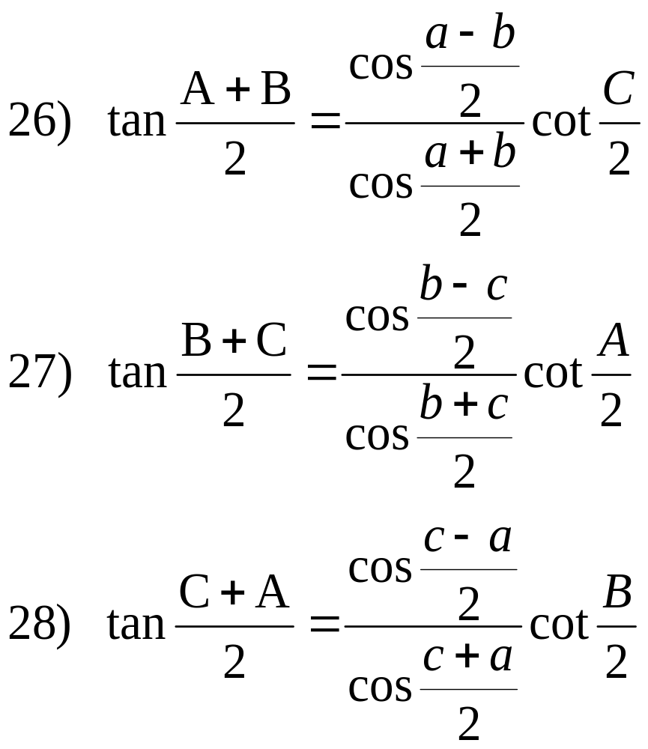
Napier’s Analogies
By applying formulas (17) to (22) to the polar triangle A’B’C’ of the triangle ABC and the supplementary relations:

Slide 37
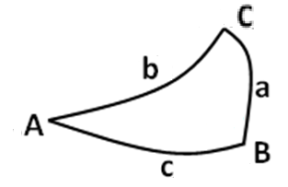
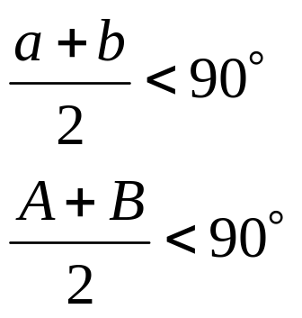
Law of Species
Law of Species
Two angles (or two sides) of a spherical triangle are said to be of the same species if they are both acute or both obtuse; and of different species if one is acute and the other obtuse.
The law may be stated as:
“One-half the sum of any two sides of a spherical triangle and one-half the sum of the opposite angles are of the same species.”
They are of the same species.

Slide 38
Solutions of Oblique Spherical Triangles
Solution of Oblique Spherical Triangles
Any three of the six parts are sufficient to solve an oblique spherical triangle.
CASE I. Three side
CASE II. Three angles
CASE III. Two angles and their include side
CASE IV. Two sides and their included angle
CASE V. Two sides and an angle opposite one of them
CASE VI. Two angles and a side opposite one of them

Slide 39
Solutions of Oblique Spherical Triangles
List of Solutions:
CASE I. Three sides are given.
Law of Cosines for Sides, formulas (2), (3), (4) or
Half-Angle Formulas (8), (9), (10), (11), (12) and (13)
CASE II. Three angles are given.
Law of Cosines for Angles, formulas (5), (6), (7) or
Half-Side Formulas (14), (15), (16)
CASE III. Two angles and their include side are given.
Napier’s Analogies, formulas (17) to (28)
CASE IV. Two sides and their included angle are given.
Napier’s Analogies, formulas (17) to (28)
CASE V. Two sides and an angle opposite one of them are given.
Law of Sine,(1) and Napier’s Analogies
CASE VI. Two angles and a side opposite one of them are given.
Law of Sine,(1) and Napier’s Analogies

Slide 40
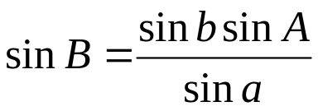
Solutions of Oblique Spherical Triangles
In CASE I, angles A,B, and C are determined without ambiguity.
CASE II has similar procedure as Case I.
In CASE III, we compute half the sum of two sides and half their difference and then find the sides (that is, we use two equations and solve simultaneously the two sides). And the remaining angle may then be computed without ambiguity.
CASE IV has an identical procedure as in Case III.
CASE V and CASE VI have identical procedures where ambiguities exist.
Illustration: Given: a, b, and B
By equation (1) of Law of Sines:
From this relation, B can have two or one or no value (if sin B>1).
Value of B is rejected if it is equal or greater than180° or if it violates the Law of Species.

Slide 41
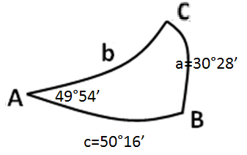
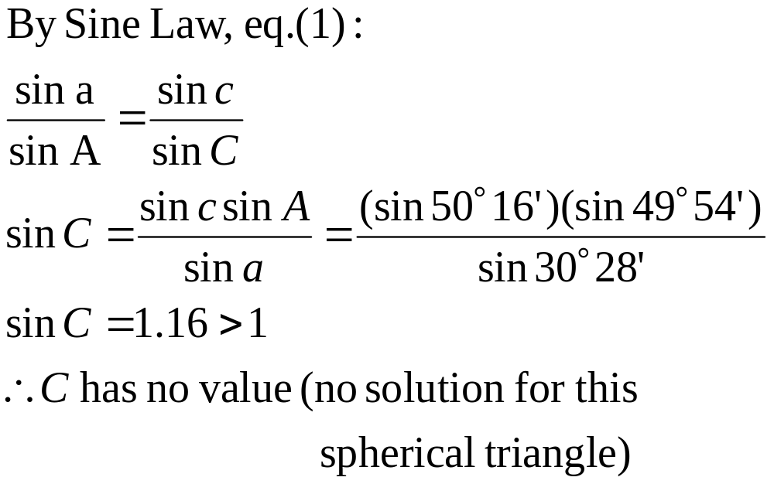
Solutions of Oblique Spherical Triangles
Sample Problem:
1. Given: a=30°28’; c=50°16’; A=49°54’
This is Case V: two side and an angle opposite one of them are given.
Notes:
This

Slide 42
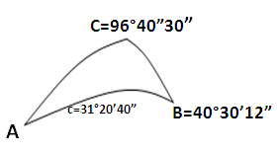
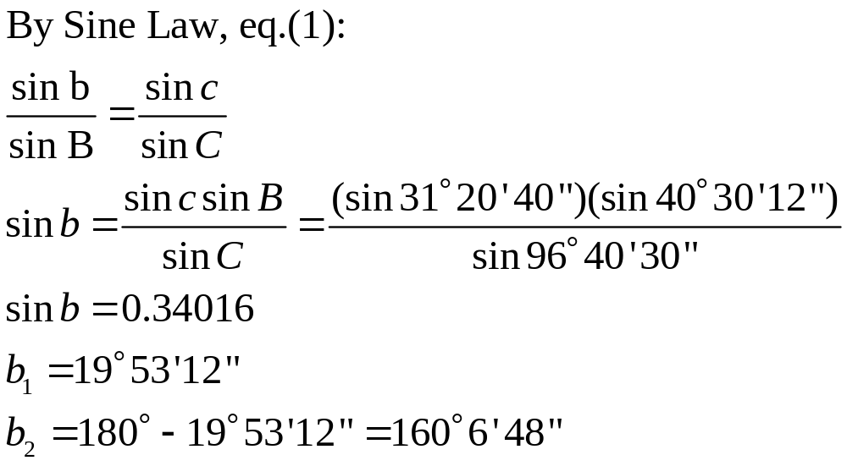
Solutions of Oblique Spherical Triangles
Sample Problem:
2. Solve the spherical triangle
B=40°30’12”; C=96°40’30”; c=31°20’40”
This is Case VI: two angles and a side opposite one of them are given.
Notes:
This

Slide 43
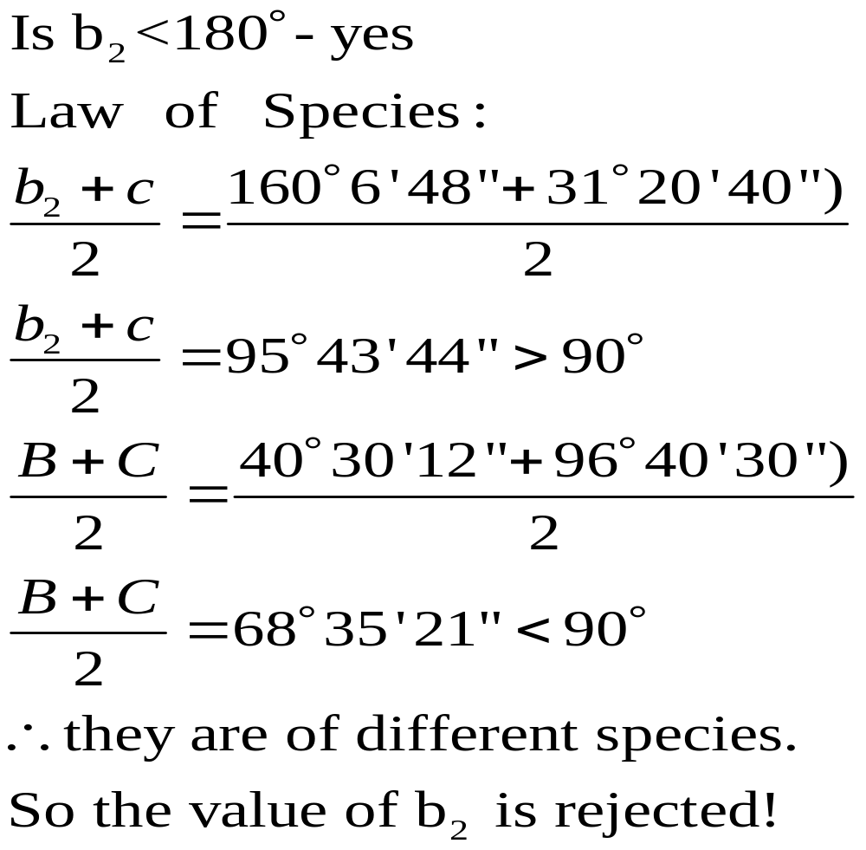
Solutions of Oblique Spherical Triangles
Check for ambiguity:
Notes:
This

Slide 44

Solutions of Oblique Spherical Triangles
Using Napier’s Analogies: formula (24) or (27)
Notes:
This

Slide 45


Solutions of Oblique Spherical Triangles
Using Law of Cosines, eq.(2)
Or by Law of Sines, eq.(1)
Notes:
This

Slide 46
Homework No. 7
HW 7:
1. Given: A=52°30’
B=70°15’
C=120°15’
Solve the other parts.
2. Given: A=40°18’
B=75°
C=100°10’
Solve by using sine law and Napier’s Analogy.
3. Solve the following right spherical triangle using Napier’s Rules, C=90°:
a. a=50° 0.8’
b=79° 57.3’
b. a=61°
B=123° 40.2’
Notes:
This

